Slide 1
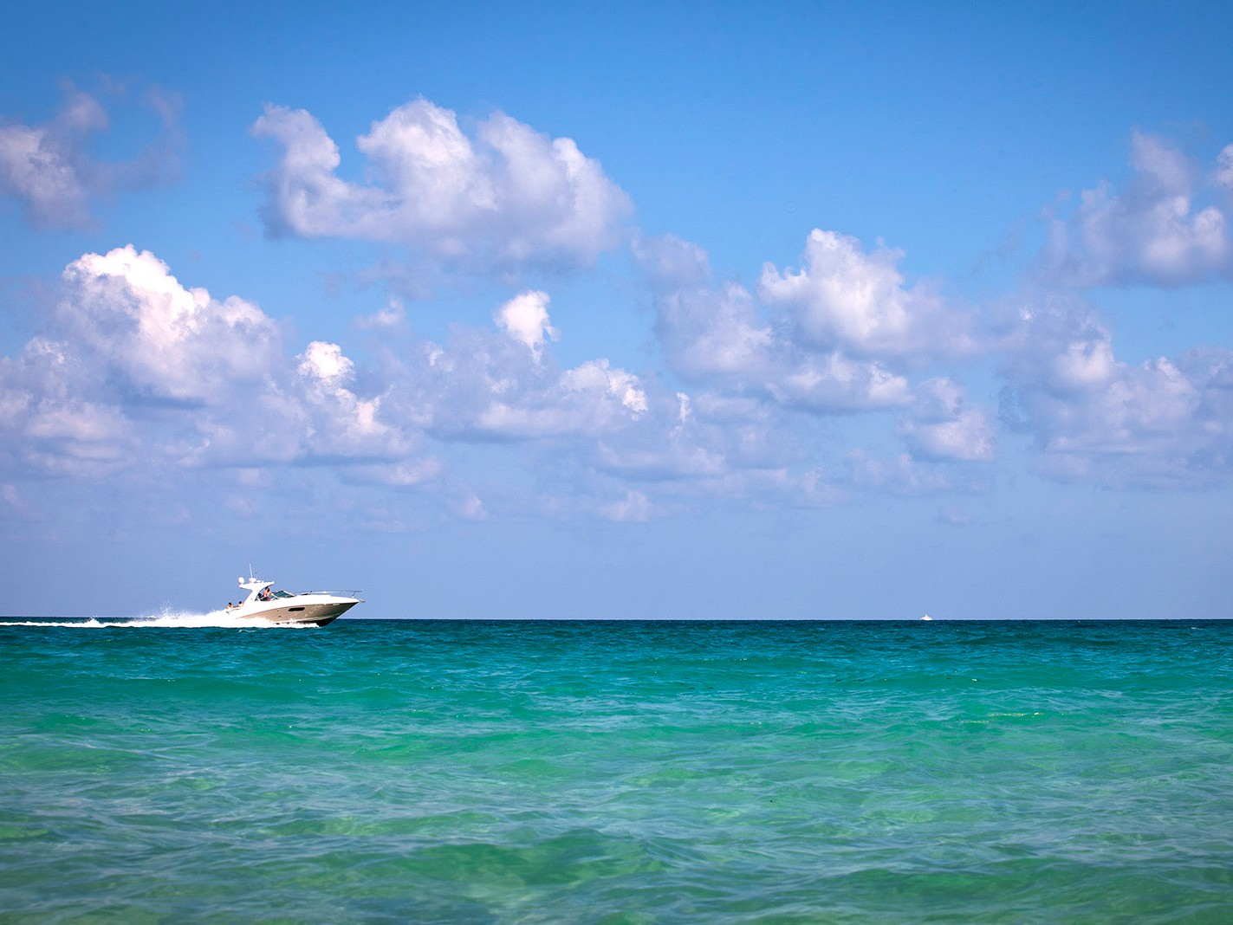


MUSSEL MATTERS
Exponential Growth of Zebra and Quagga Mussels
Dan Kosmayer / Shutterstock

Slide 2
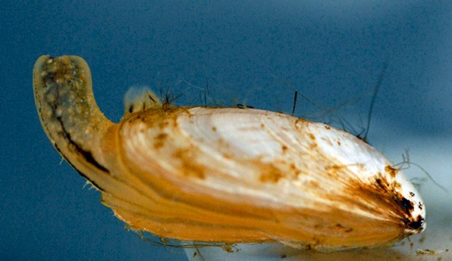
MUSSEL MATTERS
Exponential Growth of Zebra and Quagga Mussels
Mike Quigley, NOAA, Bugwood.org
Dan Kosmayer / Shutterstock
Notes:
Intent:
The theme of this presentation is how invasive species—particularly zebra and quagga mussels—are impacting public waterways as well as what we can do to prevent their spread. All slides can be customized to reflect the U.S. Army Corps of Engineers location at which the program will be given as well as the use of partner logos.
Background:
The presentation will be best augmented by use of the materials in the Traveling Trunk. Gather these items:
Zebra/quagga mussel hands-on specimens
Worksheets for STEM calculations and Action Plans
Invasive species hands-on specimens and identification cards
Common Core Standards:
The following common core standards are the inspiration for this presentation. In the talking points that follow, we are suggesting one method of presentation. Modifications could be made to suit the class skill set or interest levels.
CCSS.Ecosystems.HS.LS2.6
Evaluate claims, evidence, and reasoning that the complex interactions in ecosystems maintain relatively consistent numbers and types of organisms in stable conditions, but changing conditions may result in a new ecosystem.[Clarification Statement: Examples of changes in ecosystem conditions could include modest biological or physical changes, such as moderate hunting or a seasonal flood; and extreme changes, such as volcanic eruption or sea level rise.]
CCSS.Interpreting Functions.7.e
Graph exponential and logarithmic functions, showing intercepts and end behavior, and trigonometric functions, showing period, midline, and amplitude.
CCSS.ELA.Literacy.W.11-12.7
Conduct short as well as more sustained research projects to answer a question (including a self-generated question) or solve a problem; narrow or broaden the inquiry when appropriate; synthesize multiple sources on the subject, demonstrating understanding of the subject under investigation.
Talking Points:
Good morning, I am [insert name], Park Ranger at [insert location]. Today, we will learn how invasive mussels are impacting the lake.

Slide 3
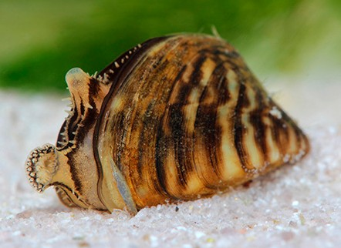
MUSSEL MATTERS
Exponential Growth of Zebra and Quagga Mussels
Vitali Hulai / Shutterstock
Mike Quigley, NOAA, Bugwood.org
Dan Kosmayer / Shutterstock
Notes:
Intent:
The theme of this presentation is how invasive species—particularly zebra and quagga mussels—are impacting public waterways as well as what we can do to prevent their spread. All slides can be customized to reflect the U.S. Army Corps of Engineers location at which the program will be given as well as the use of partner logos.
Background:
The presentation will be best augmented by use of the materials in the Traveling Trunk. Gather these items:
Zebra/quagga mussel hands-on specimens
Worksheets for STEM calculations and Action Plans
Invasive species hands-on specimens and identification cards
Common Core Standards:
The following common core standards are the inspiration for this presentation. In the talking points that follow, we are suggesting one method of presentation. Modifications could be made to suit the class skill set or interest levels.
CCSS.Ecosystems.HS.LS2.6
Evaluate claims, evidence, and reasoning that the complex interactions in ecosystems maintain relatively consistent numbers and types of organisms in stable conditions, but changing conditions may result in a new ecosystem.[Clarification Statement: Examples of changes in ecosystem conditions could include modest biological or physical changes, such as moderate hunting or a seasonal flood; and extreme changes, such as volcanic eruption or sea level rise.]
CCSS.Interpreting Functions.7.e
Graph exponential and logarithmic functions, showing intercepts and end behavior, and trigonometric functions, showing period, midline, and amplitude.
CCSS.ELA.Literacy.W.11-12.7
Conduct short as well as more sustained research projects to answer a question (including a self-generated question) or solve a problem; narrow or broaden the inquiry when appropriate; synthesize multiple sources on the subject, demonstrating understanding of the subject under investigation.
Talking Points:
Good morning, I am [insert name], Park Ranger at [insert location]. Today, we will learn how invasive mussels are impacting the lake.

Slide 4
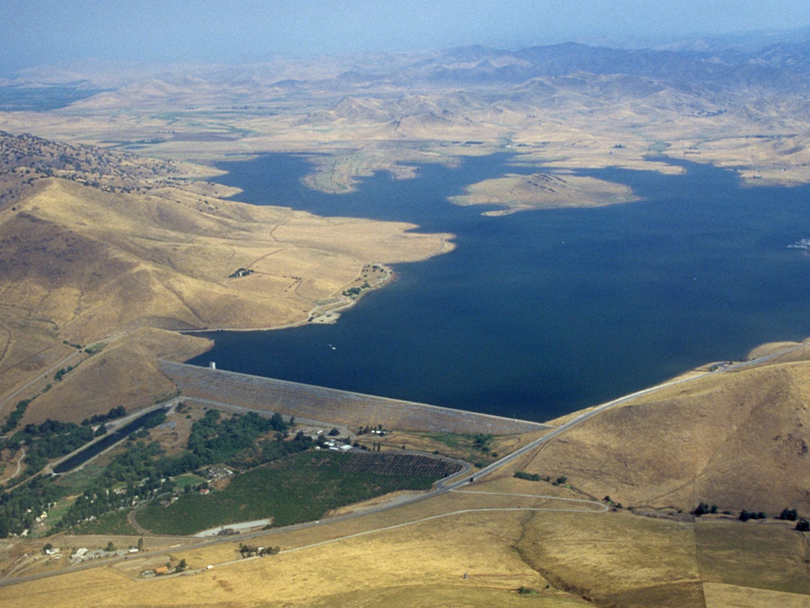


VISITING [INSERT LOCATION]
Michael J. Nevins / U.S. Army

Slide 5
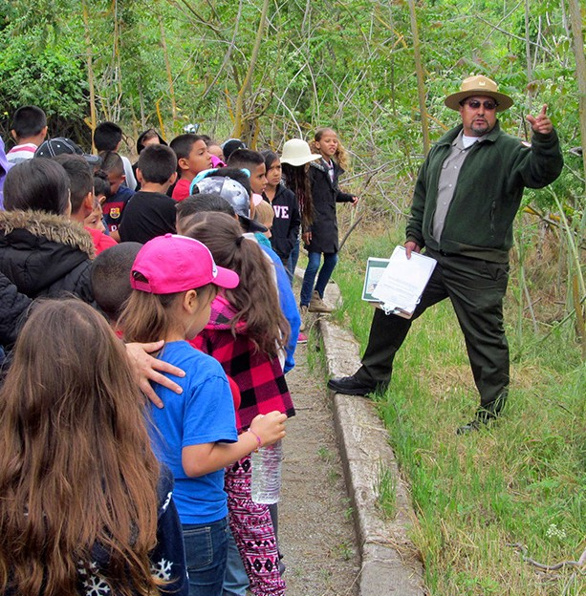
VISITING [INSERT LOCATION]
USACE
Michael J. Nevins / U.S. Army
Notes:
Talking Points:
The U.S. Army Corps of Engineers is the premiere federal agency for engineering and water resource management, dedicated to maintaining a proper and healthy balance of the varying uses of the nation’s waterways. The Corps operates approximately 700 dams that provide significant benefits such as flood risk management, navigation, water supply, hydropower, environmental stewardship, fish and wildlife conservation, and recreation.
Add highlights of recreational access at this Corps location.

Slide 6
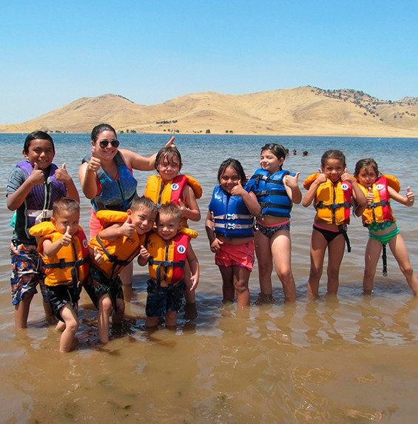
VISITING [INSERT LOCATION]
USACE
USACE
Michael J. Nevins / U.S. Army
Notes:
Talking Points:
The U.S. Army Corps of Engineers is the premiere federal agency for engineering and water resource management, dedicated to maintaining a proper and healthy balance of the varying uses of the nation’s waterways. The Corps operates approximately 700 dams that provide significant benefits such as flood risk management, navigation, water supply, hydropower, environmental stewardship, fish and wildlife conservation, and recreation.
Add highlights of recreational access at this Corps location.

Slide 7
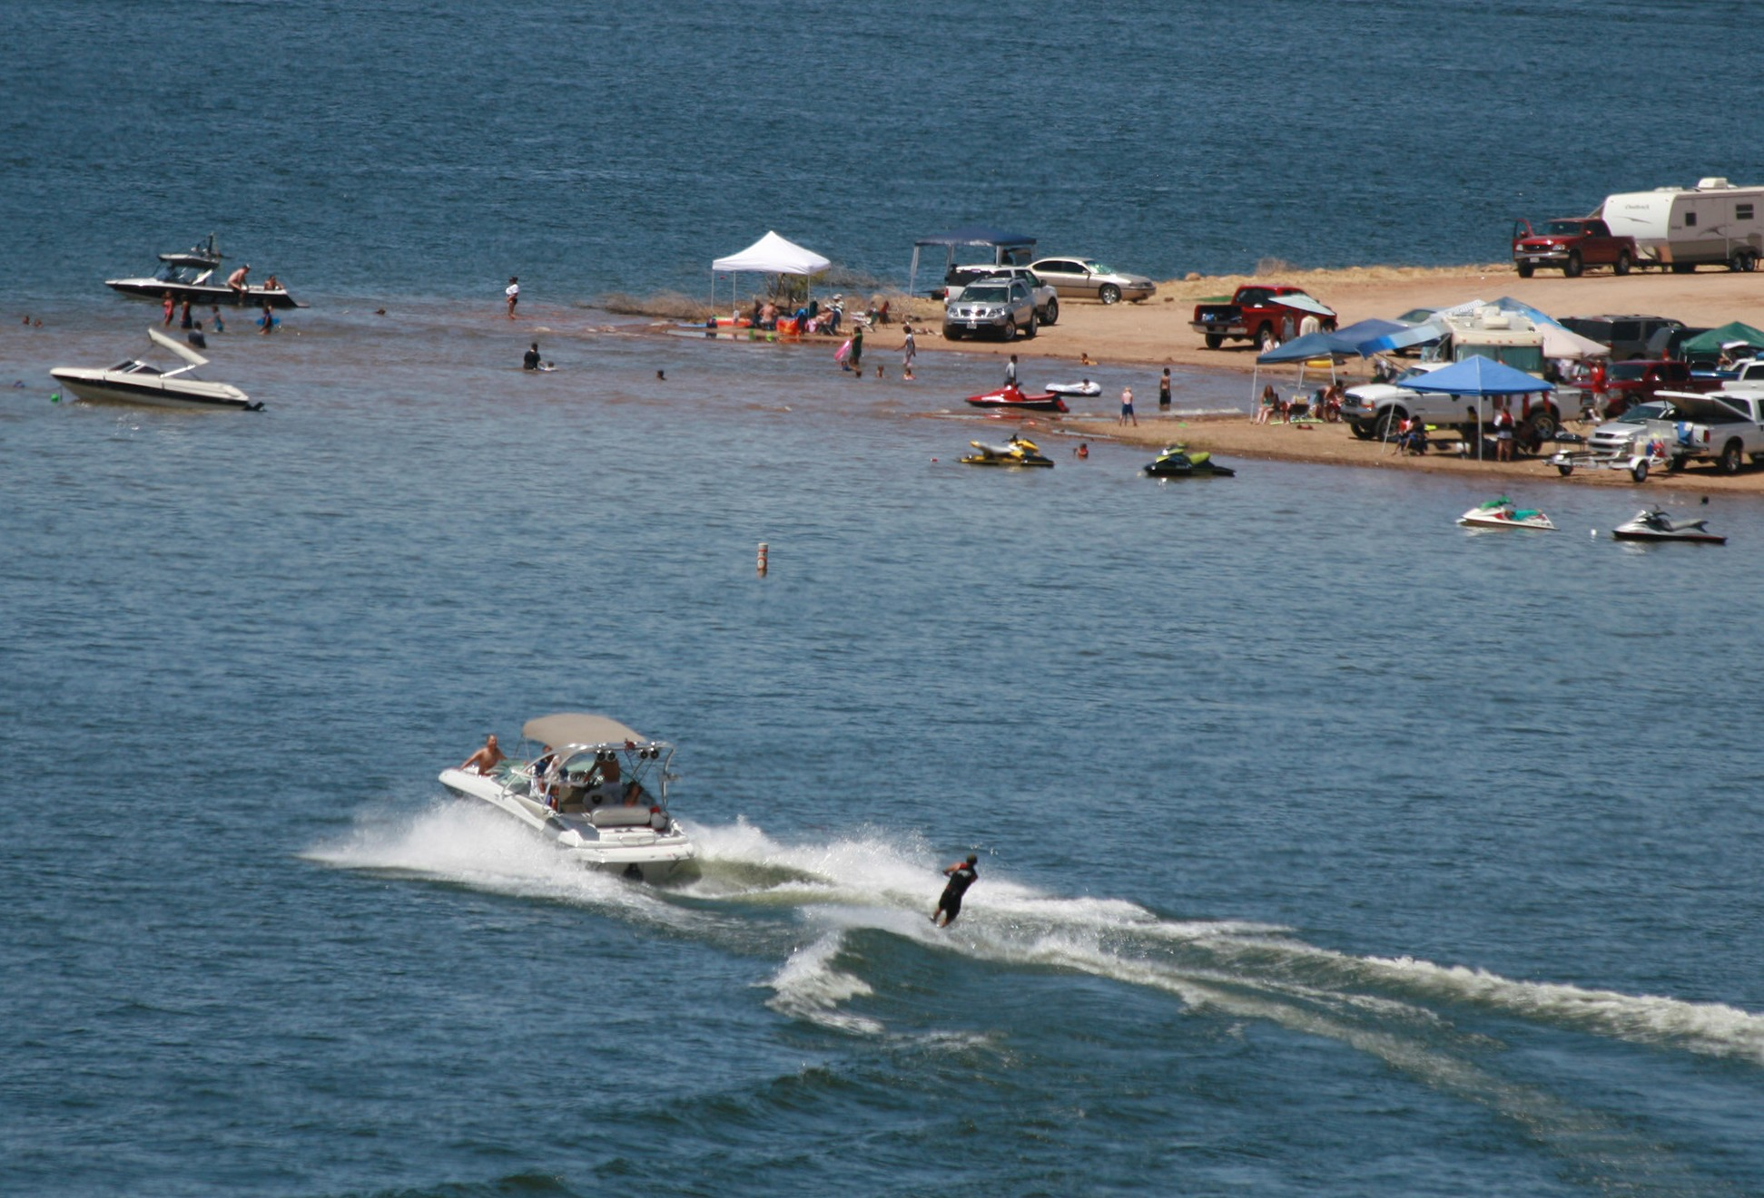
VISITING [INSERT LOCATION]
USACE
USACE
USACE
Michael J. Nevins / U.S. Army
Notes:
Talking Points:
The U.S. Army Corps of Engineers is the premiere federal agency for engineering and water resource management, dedicated to maintaining a proper and healthy balance of the varying uses of the nation’s waterways. The Corps operates approximately 700 dams that provide significant benefits such as flood risk management, navigation, water supply, hydropower, environmental stewardship, fish and wildlife conservation, and recreation.
Add highlights of recreational access at this Corps location.

Slide 8
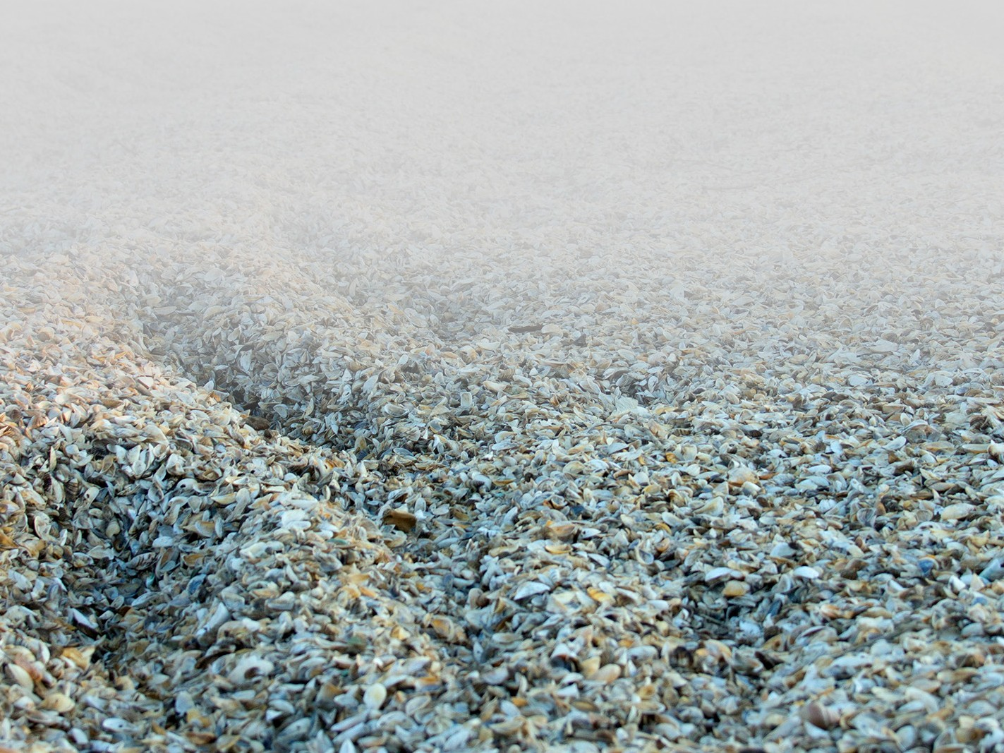
THE PROBLEM—ZEBRA AND QUAGGA MUSSELS ARE INVADING
Andrew Sabai / 123RF

Slide 9
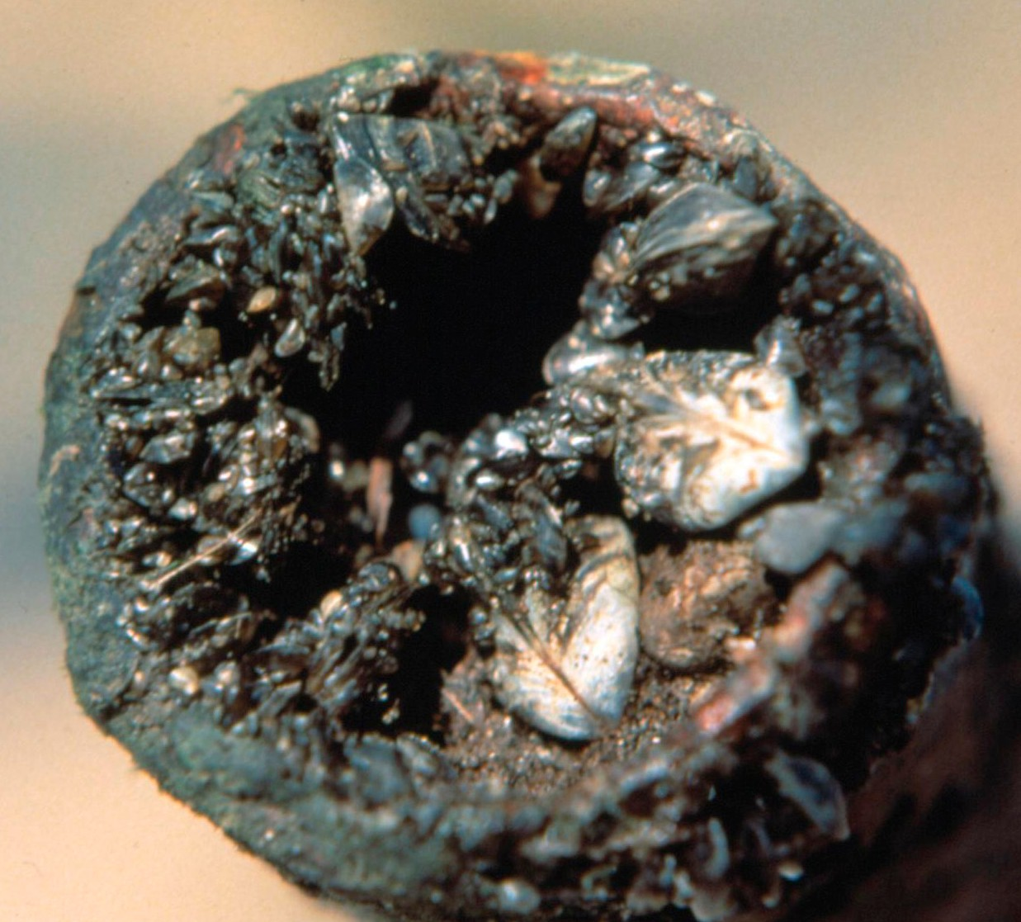
THE PROBLEM—ZEBRA AND QUAGGA MUSSELS ARE INVADING
Craig Czarnecki, Michigan Sea Grant, Bugwood.org
Andrew Sabai / 123RF
Notes:
Talking Points
Zebra and quagga mussels pose a great ecological and financial threat. They clog water infrastructure, impacting water supply and quality. They attach to most underwater structures and can form dense clusters that impair facilities and impede the flow of water. They clog pipes, screens, canals, aqueducts, and dams. They degrade water quality and can alter the taste and smell of drinking water.
They can change aquatic ecosystems and native plant and animal communities. The amount of food they eat and the waste they produce have life-altering effects on the ecosystems and fisheries. As filter feeders, they remove large amounts of microscopic plants and animals that form the base of the food chain, leaving little or nothing for native aquatic species.
They encrust docks and boats and can get into engine cooling systems. The weight of attached mussels can sink buoys, breakwaters, docks and small boats.
They have significant financial impact. The maintenance costs for power plants, water treatment facilities, and water delivery infrastructure increases, as well as increasing the cost of food and utilities.
Introduce the zebra/quagga mussel hands-on specimen
As you can see here, within 6 months, zebra mussels can exponentially multiply.

Slide 10
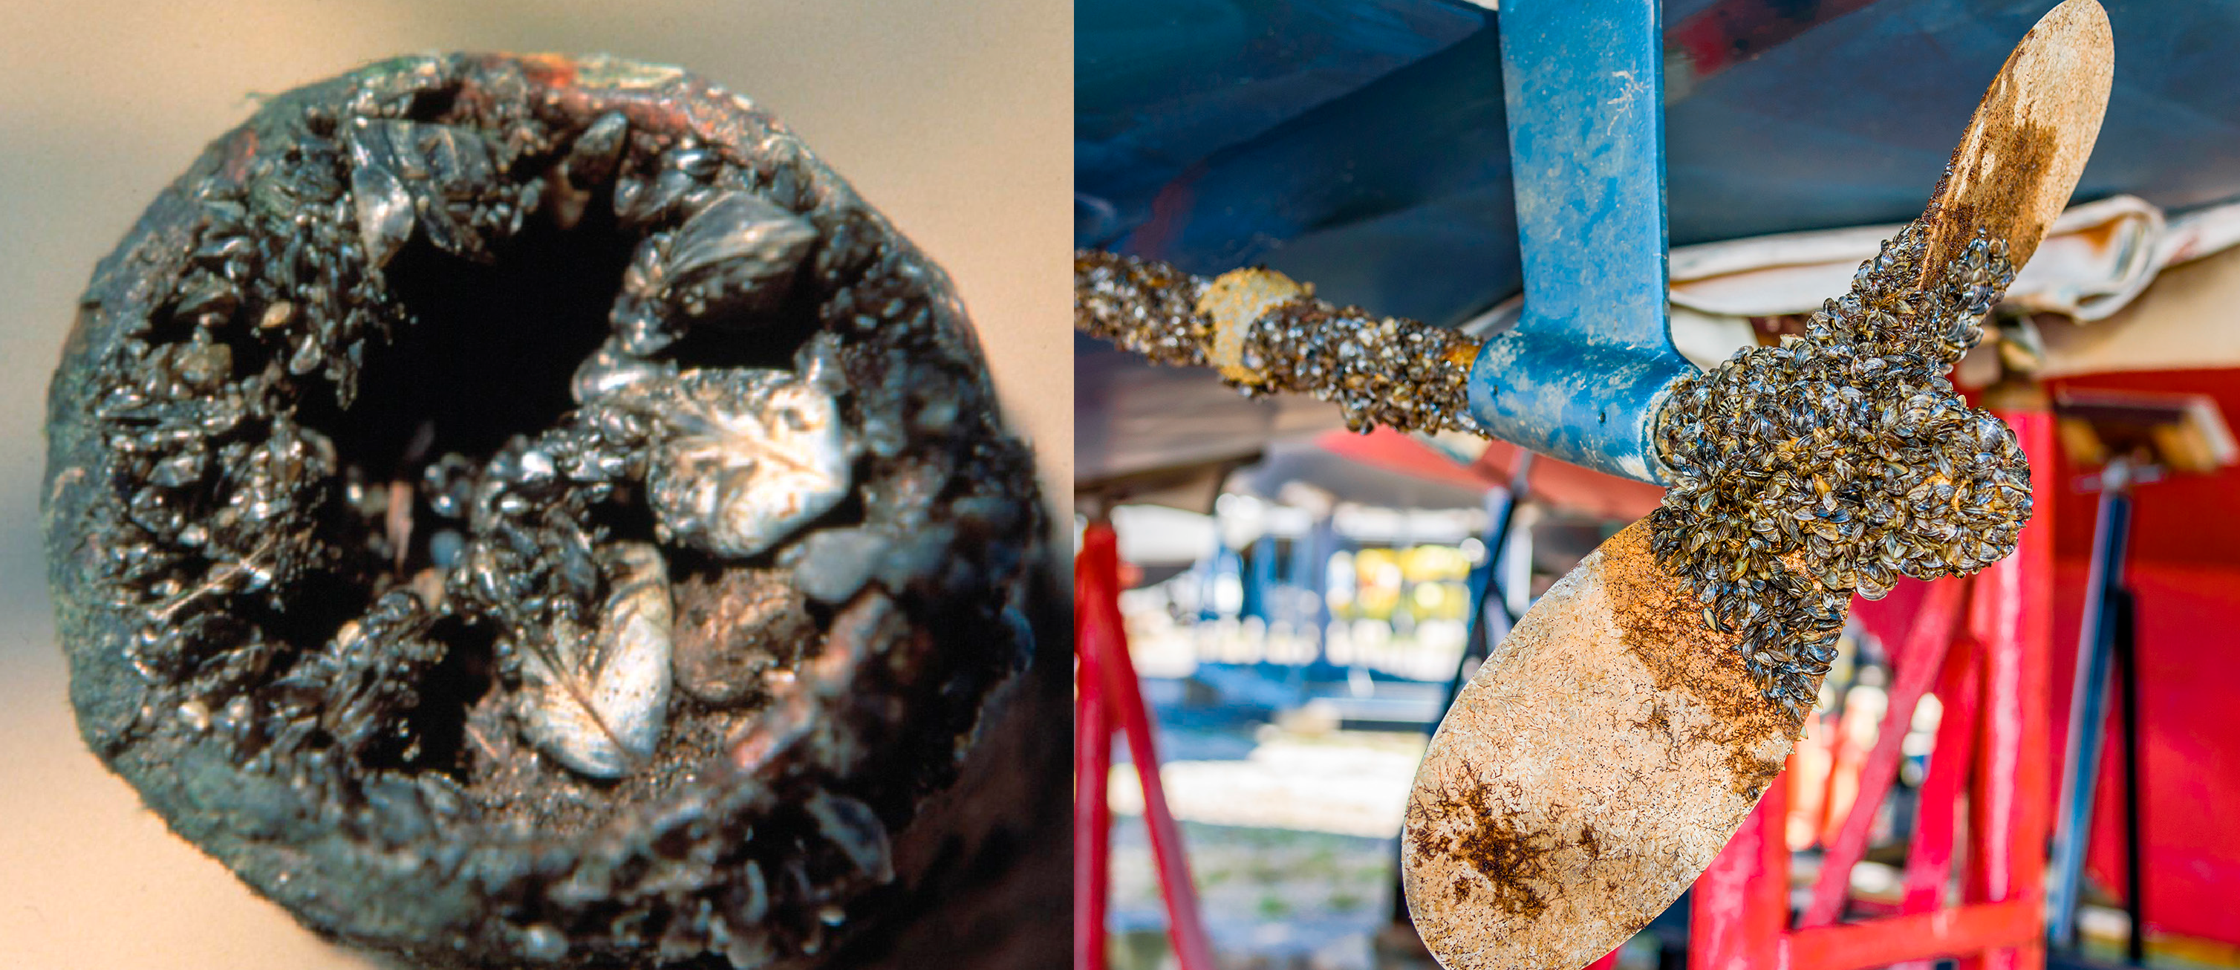
THE PROBLEM—ZEBRA AND QUAGGA MUSSELS ARE INVADING
Craig Czarnecki, Michigan Sea Grant, Bugwood.org
Jeff Caughey / Shutterstock
Andrew Sabai / 123RF
Notes:
Talking Points
Zebra and quagga mussels pose a great ecological and financial threat. They clog water infrastructure, impacting water supply and quality. They attach to most underwater structures and can form dense clusters that impair facilities and impede the flow of water. They clog pipes, screens, canals, aqueducts, and dams. They degrade water quality and can alter the taste and smell of drinking water.
They can change aquatic ecosystems and native plant and animal communities. The amount of food they eat and the waste they produce have life-altering effects on the ecosystems and fisheries. As filter feeders, they remove large amounts of microscopic plants and animals that form the base of the food chain, leaving little or nothing for native aquatic species.
They encrust docks and boats and can get into engine cooling systems. The weight of attached mussels can sink buoys, breakwaters, docks and small boats.
They have significant financial impact. The maintenance costs for power plants, water treatment facilities, and water delivery infrastructure increases, as well as increasing the cost of food and utilities.
Introduce the zebra/quagga mussel hands-on specimen
As you can see here, within 6 months, zebra mussels can exponentially multiply.

Slide 11
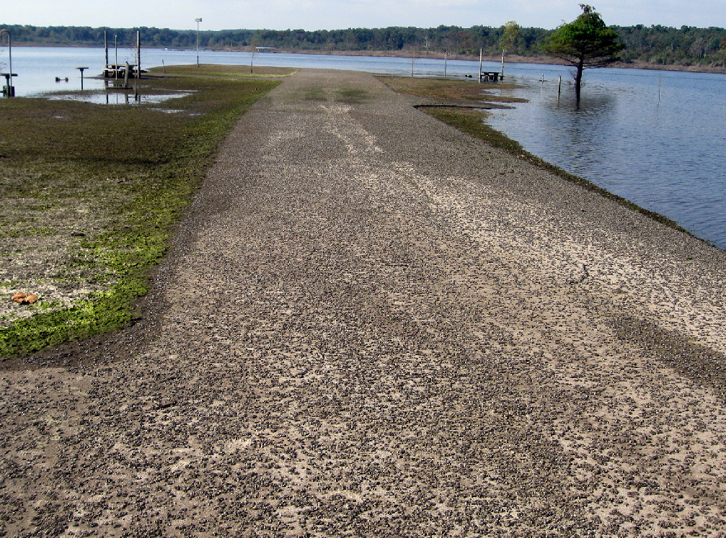
THE PROBLEM—ZEBRA AND QUAGGA MUSSELS ARE INVADING
Craig Czarnecki, Michigan Sea Grant, Bugwood.org
Jeff Caughey / Shutterstock
USACE
Andrew Sabai / 123RF
Notes:
Talking Points
Zebra and quagga mussels pose a great ecological and financial threat. They clog water infrastructure, impacting water supply and quality. They attach to most underwater structures and can form dense clusters that impair facilities and impede the flow of water. They clog pipes, screens, canals, aqueducts, and dams. They degrade water quality and can alter the taste and smell of drinking water.
They can change aquatic ecosystems and native plant and animal communities. The amount of food they eat and the waste they produce have life-altering effects on the ecosystems and fisheries. As filter feeders, they remove large amounts of microscopic plants and animals that form the base of the food chain, leaving little or nothing for native aquatic species.
They encrust docks and boats and can get into engine cooling systems. The weight of attached mussels can sink buoys, breakwaters, docks and small boats.
They have significant financial impact. The maintenance costs for power plants, water treatment facilities, and water delivery infrastructure increases, as well as increasing the cost of food and utilities.
Introduce the zebra/quagga mussel hands-on specimen
As you can see here, within 6 months, zebra mussels can exponentially multiply.

Slide 12
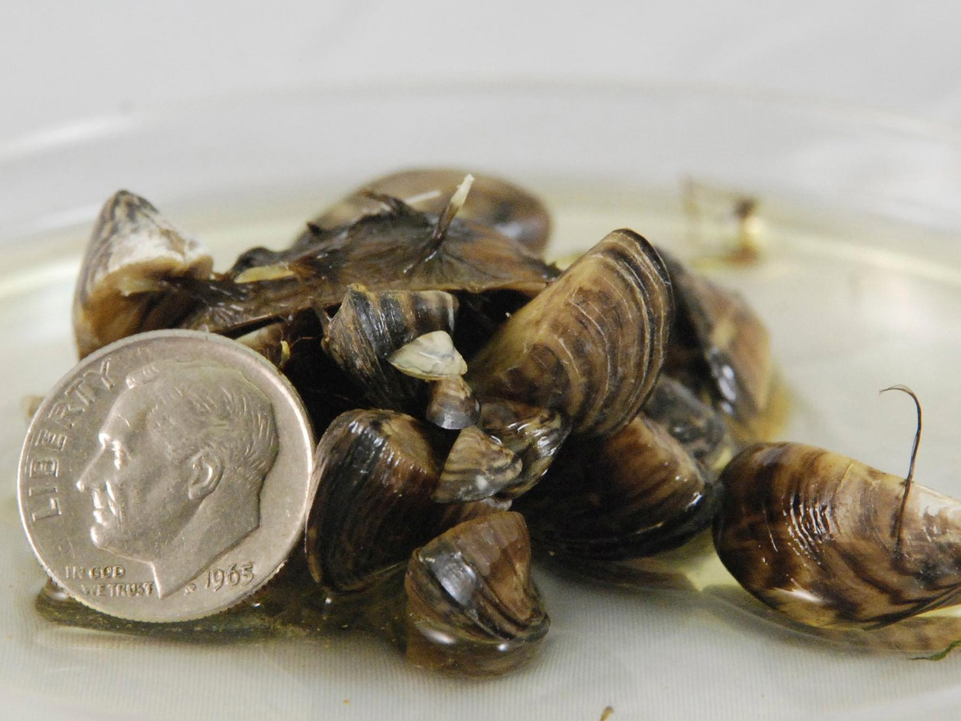
EXPONENTIAL EXPLOSION!
From a Few to Septillions
California Department of Fish and Wildlife, Bugwood.org

Slide 13

EXPONENTIAL EXPLOSION!
From a Few to Septillions
Ktasimer / Adobe Stock
California Department of Fish and Wildlife, Bugwood.org
Notes:
Talking Points:
Let’s calculate how fast an invasive zebra or quagga mussel population can take over a waterway. A single female can produce up to one million eggs a year. Even if only 10% survive, there would be a huge number within 5 years. Let’s calculate their growth.
Let’s assume a few things. First, let’s say 100,000 eggs survived and thrived. Second, let’s say the growth rate is 60%. How many more mussels will there be in 5 years?
Express the growth rate as a decimal (.6). A growth rate is expressed as 1 plus the rate of growth and a decay rate would be expressed as 1 minus the rate of decay. Write out our rate of growth:
b = 1+.6
b = 1.6
Populate the equations with known variables:
y = 100,000 (1.6) ⁵
Multiply the growth rate by the time:
y = 100,000 (8)
Solve for the answer
y = 800,000
As you can imagine, this exponential growth can choke waterways within years, forcing our recreation area to close for swimming and boating.
You could help illustrate this by having one student shake hands with two students and then those two students each shake hands with two other students, and so forth until all the students have shaken hands.
For more advanced students, one option is to solve for continuous exponential growth using the formula A=Pert with the exponential constant being 2.71.
If possible, give real examples with data from Corps lakes where invasive mussels have forced the closure of recreation area.

Slide 14
EXPONENTIAL EXPLOSION!
From a Few to Septillions
CONTINUOUS EXPONENTIAL GROWTH
y=ab^{x}
Ktasimer / Adobe Stock
California Department of Fish and Wildlife, Bugwood.org

Slide 15
EXPONENTIAL EXPLOSION!
From a Few to Septillions
CONTINUOUS EXPONENTIAL GROWTH
final population
rate of growth or decay
y=ab^{x}
initial population
exponent, time
Ktasimer / Adobe Stock
California Department of Fish and Wildlife, Bugwood.org

Slide 16
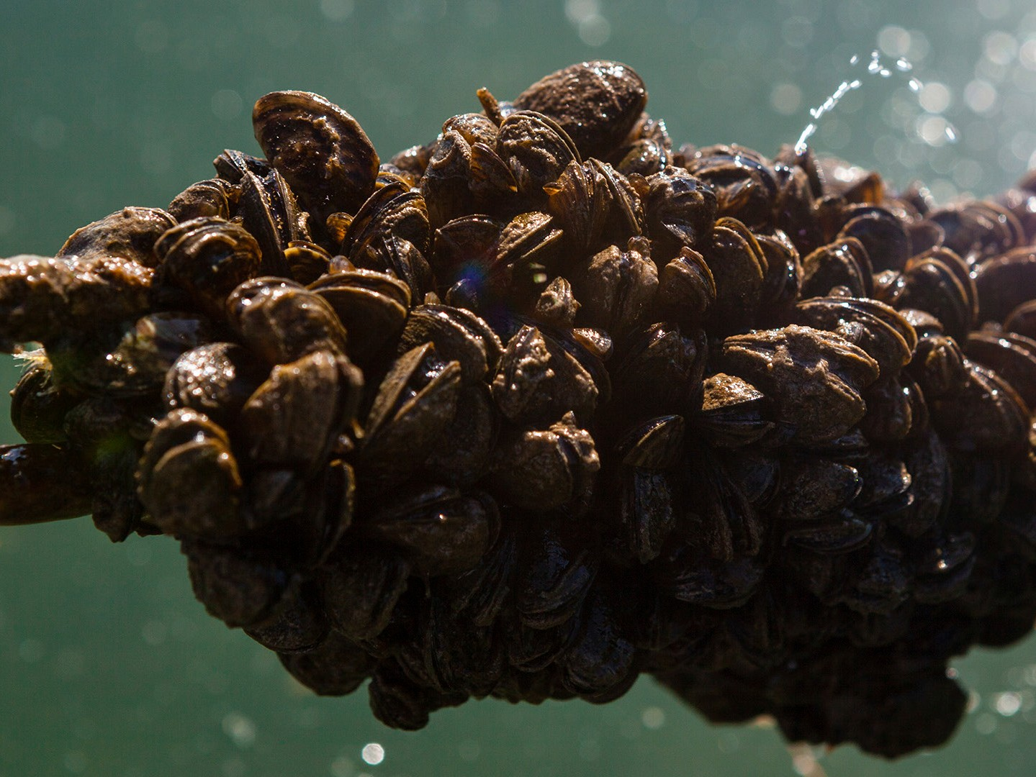
PREVENTION IS KEY
Will Parson / Chesapeake Bay Program

Slide 17

PREVENTION IS KEY
Will Parson / Chesapeake Bay Program
Notes:
Talking Points
Now that we know how quickly invasive mussel can take over, how do we get rid of them? Once introduced into a waterbody, they are very difficult to remove. Managers have only eradicated zebra and quagga mussels in isolated conditions where lakes can be drained, and chemical treatments can be applied. This has only been done in a couple of circumstances. In general, eradication is not feasible once a lake is infested with mussels. Large bodies of water and connected waterways cannot be drained and treated. Prevention is critical.
To protect water where you recreate, here are the actions to take:
Remove visible mud, plants, fish or animals from your boat, trailer and other gear.
Drain water from equipment before you leave.
Clean and dry anything that came in contact with water including your boat, trailer, gear, clothing and pets.

Slide 18

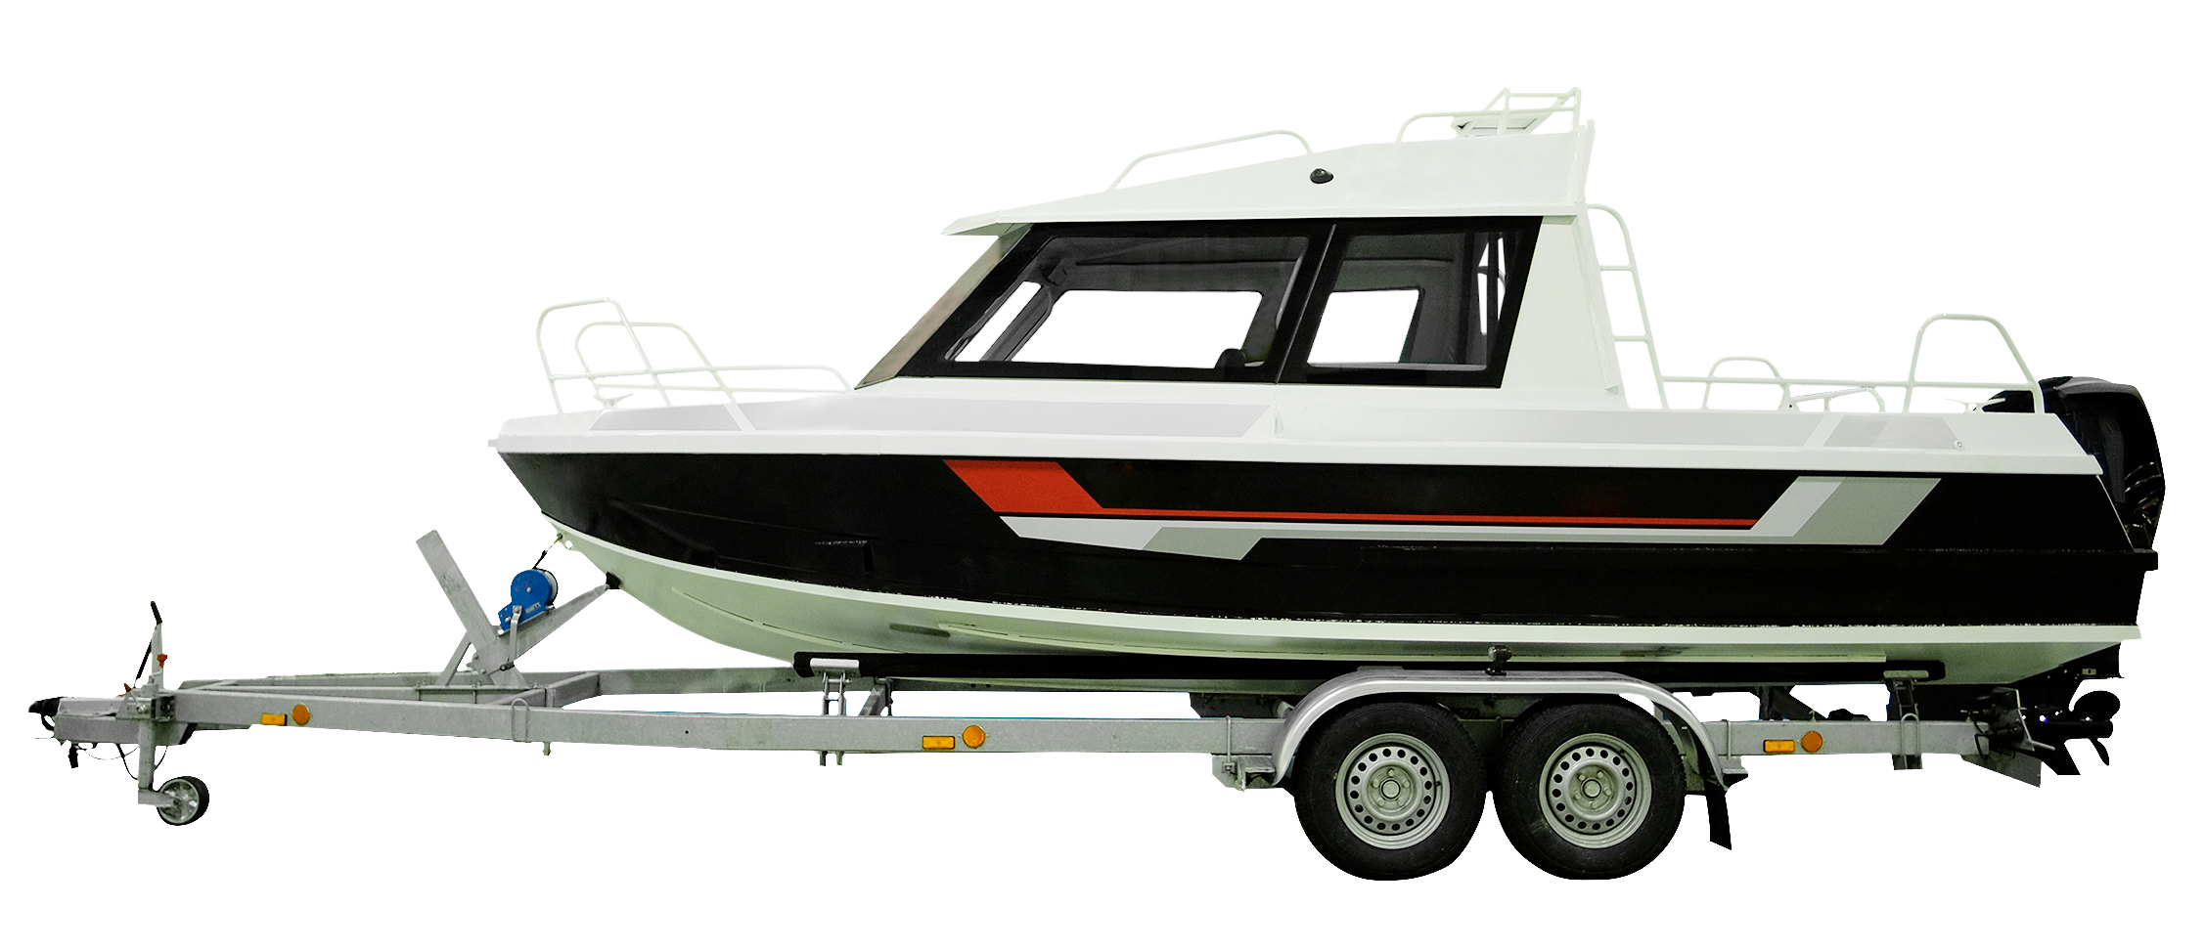





PREVENTION IS KEY
Vereshchagin Dmitry / Shutterstock.com
Will Parson / Chesapeake Bay Program
Notes:
Talking Points
Now that we know how quickly invasive mussel can take over, how do we get rid of them? Once introduced into a waterbody, they are very difficult to remove. Managers have only eradicated zebra and quagga mussels in isolated conditions where lakes can be drained, and chemical treatments can be applied. This has only been done in a couple of circumstances. In general, eradication is not feasible once a lake is infested with mussels. Large bodies of water and connected waterways cannot be drained and treated. Prevention is critical.
To protect water where you recreate, here are the actions to take:
Remove visible mud, plants, fish or animals from your boat, trailer and other gear.
Drain water from equipment before you leave.
Clean and dry anything that came in contact with water including your boat, trailer, gear, clothing and pets.

Slide 19
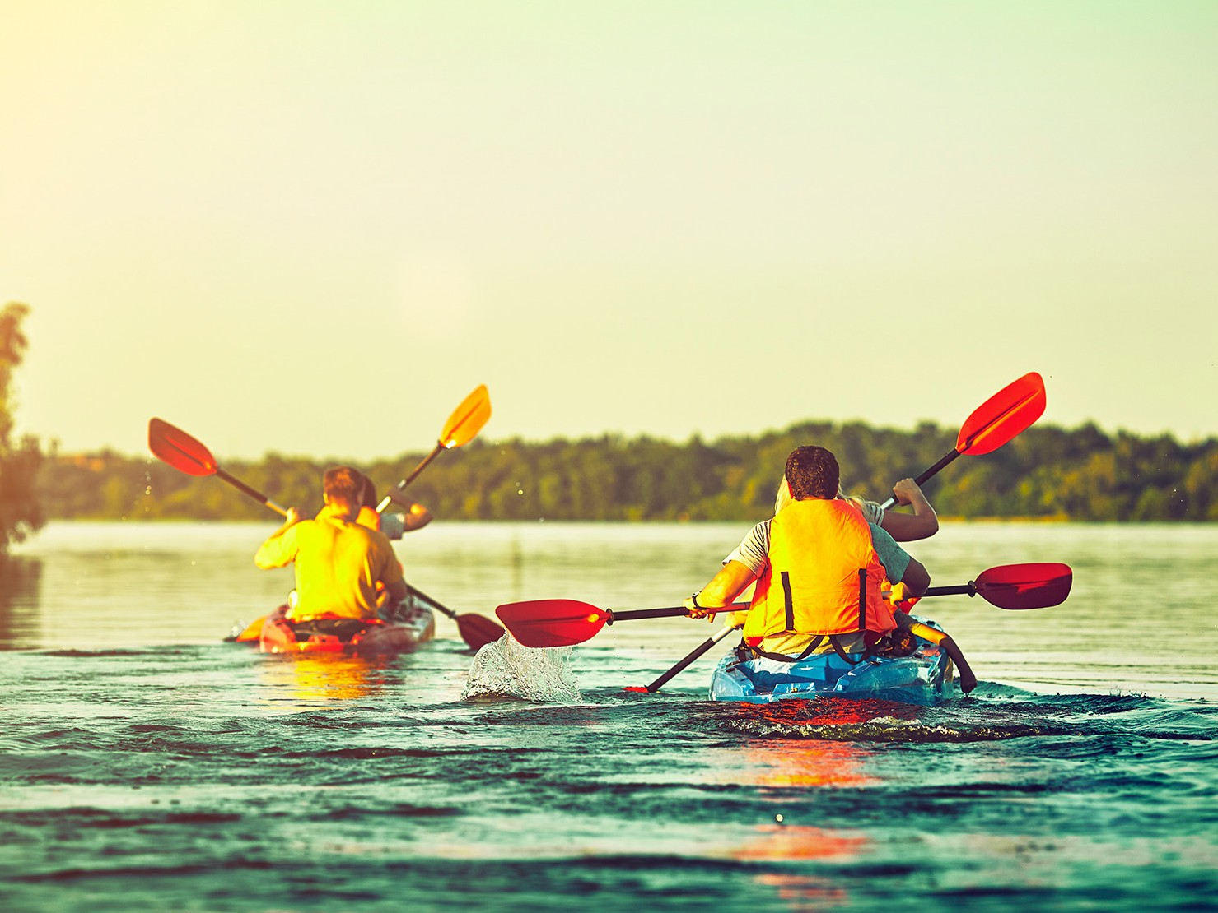
DEVELOP AN ACTION PLAN
6okean / Adobe Stock

Slide 20

DEVELOP AN ACTION PLAN
Colby / Adobe Stock
6okean / Adobe Stock
Notes:
Talking Points
Introduce the invasive species specimens and identification cards.
Examine all the invasive species that threaten our lands and waters. How do these species get around? How are we helping these species invade new ecosystems?
Let’s develop an action plan to stop their spread. In addition to zebra and quagga mussels, select three invasives that threaten your favorite recreational activities. Write an action plan to help prevent these species from becoming established in your community. Get the word out and share with others.

Slide 21

DEVELOP AN ACTION PLAN
Colby / Adobe Stock
K. Thalhofer / Adobe Stock
6okean / Adobe Stock
Notes:
Talking Points
Introduce the invasive species specimens and identification cards.
Examine all the invasive species that threaten our lands and waters. How do these species get around? How are we helping these species invade new ecosystems?
Let’s develop an action plan to stop their spread. In addition to zebra and quagga mussels, select three invasives that threaten your favorite recreational activities. Write an action plan to help prevent these species from becoming established in your community. Get the word out and share with others.
Our efforts can make a difference!
Questions?

